Slide 1
LINQ

Slide 2
Objectives
In general terms, explain how LINQ works
Describe what LINQ providers are
List the advantages of LINQ
Describe the three stages of a query operation
Use any of the LINQ features presented in this chapter to code and execute a query expression against an enumerable object

Slide 3
Notes:
An Introduction to LINQ
LINQ, or Language-Integrated Query lets you query a data source using the C# language.
In practice, this means you can query five different types of data sources (Objects, SQL, XML, …) with the same language, and you don't have to use a special query language like Transact-SQL.
To make that possible, C# includes the LINQ providers that are listed in slide 6.
LINQ is implemented as a set of extension methods that are defined by the IEnumerable and IQueryable interfaces. These methods are referred to as query operators.
Although you can call the query operators directly by coding a method-based query, you're more likely to use the special declarative expression syntax that C# provides.
When you use the declarative syntax to code a LINQ query, the result is called a query expression.
To use LINQ with a data source, the data source must implement the IEnumerable<T> interface or another interface that implements IEnumerable<T> such as IQueryable<T>. A data source that implements one of these interfaces is called an enumerable type.
When you use query expressions, Visual Studio's IntelliSense helps you code the queries correctly, and the syntax checker helps you catch errors at compile time.
Visual Studio also provides debugging support.
When compared to writing SQL queries as strings, these are major improvements.

Slide 4
Notes:
An Introduction to LINQ
The query expression syntax looks similar to a SQL query, so you shouldn't have any trouble understanding what most of these clauses do.
For example:
you use the from clause to identify the data source for the query,
the where clause to filter the data that's returned by the query,
and the select clause Identifies the source of data for the query.
where provides a condition that specifies which elements are retrieved from the data source.
orderby indicates how the elements that are returned by the query are sorted.
select specifies the content of the returned elements.
let performs a calculation and assigns an alias to the result that can be used within the query.
join combines data from two data sources.
group groups the returned elements and, optionally, applies aggregate functions to each group.

Slide 5
Notes:
5
LINQ Providers
LINQ providers translate LINQ queries into a form that each data source can understand.
They also convert the returned data to the objects defined by the queries, and they convert the objects to data when the queries update a data source.
LINQ to Objects Lets you query in-memory data structures such as generic lists and arrays.
LINQ to Dataset Lets you query the data in a DataSet object.
LINQ to SQL Lets you query SQL Server database schema’s.
LINQ to Entities Lets you query an Entity Data Model (e.g. the data model generated by Entity Framework) .
LINQ to XML Lets you query and modify in-memory XML or the XML stored in a file.
LINQ to Dataset, LINQ to SQL, and LINQ to Entities all work with ADO.NET objects, they are sometimes referred to as LINQ to ADO.NET.
LINQ to Entities can be used to query an Entity Data Model.
In the next module you will learn to use Entity Framework (EF) to query a database.
EF generates an Entity Data Model in memory. So you will use LINQ to query the model and thus the database.

Slide 6
Notes:
6
LINQ providers
LINQ providers perform three main functions:
Translate queries into commands that the data source can execute.
Convert the data that's returned from a data source to the objects defined by the query.
Convert objects to data when updating a data source.

Slide 7
Notes:
Advantages of using LINQ
Language-Integrated Query (LINQ) lets you query different kinds of data sources using the same C# syntax.
IntelliSense, compile-time syntax checking, and debugging support make it easier to code a LINQ query.
Using the same syntax makes it easier to query different types of data sources.
The designer tools let you create object-relational mappings that make it easier to work with relational data sources.

Slide 8
LINQ to Objects

Slide 9
Notes:
9
3 stages of a query operation
Stage 1: Get the data source
First we need to obtain an object that we can use as datasource. The only condition is that the datasource object implements the IEnumerable<T> interface.
An array of integers, for example, could be a datasource because it implements Ienumberable<int>.
Stage 2: Define the query expression
Next we create a query expression. An import thing to realize is that creating the query expression does not execute it yet.
Stage 3: Execute the query
It is not until we start iterating over the linq query object (e.g. by executing a foreach) that the query is executed and the results are returned.

Slide 10
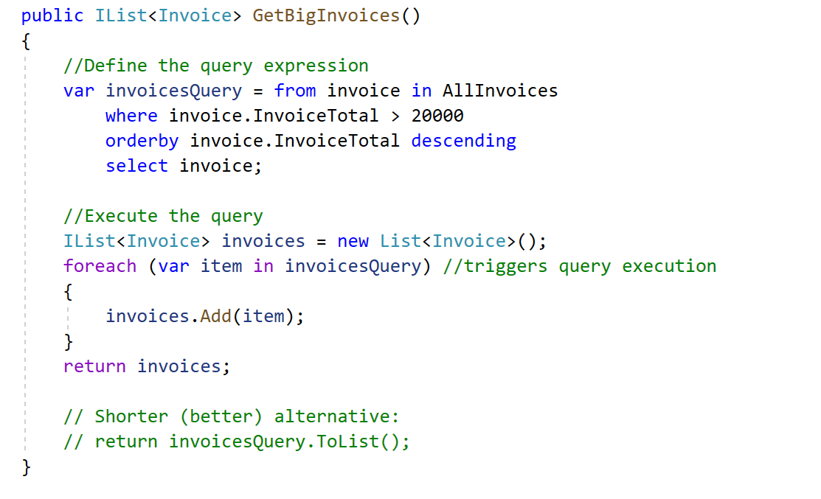
A LINQ Query with Defered Execution
Notes:
Deferred execution
The example this slide presents the three stages of a query operation and illustrates these stages using a generic list (which implements IEnumberable<T>.
This example uses LINQ to Objects, but you use the same techniques with other LINQ providers.
In Linq to Objects the result of a Linq query is again an IEnumberable<T>.
The first stage is to get the data source.
How you do that depends on the type of datasource you're working with. For a generic list, getting the datasource means declaring a variable to hold the list and then calling a method that returns the list.
In this example, the AllInvoices property (which, in turn, calls the GetAll method of an InvoiceRepository class) is used to return an IList<Invoice> object.
The second stage is to define the query expression.
This expression identifies the data source and the data to be retrieved from that data source.
For instance, the query expression on this slide retrieves all the invoices with an invoice total greater than 20,000.
It also sorts those invoices by invoice total in descending sequence.
Notice here that the query expression is stored in a query variable named bigInvoiceQuery.
That's necessary because this query isn't executed when it's defined. Also notice that the query variable isn't declared with a type.
Instead, it's given a type implicitly based on the type of elements returned by the query.
This is one of the features of C# that supports LINQ.
In this case, because the query returns Invoice objects and is ordered, the query variable is given the type IOrderedEnumerable<Invoice>.
For this to work, the data source must be an enumerable type, which means that it implements the IEnumerable<T> interface.
Alternatively, the data source could implement the IQueryable<T> interface, since this interface implements IEnumerable<T>.
In case you aren't familiar with interfaces, they consist of a set of declarations for one or more properties, methods, and events, but they don't provide implementation for those properties, methods, and events.
For the example in this slide, all you need to know is that the IList<T> interface inherits the IEnumerable<T> interface.
The third stage of a query operation is to execute the query.
To do that, you typically use a foreach statement like the one in this figure.
Here, each element that's returned by the query expression is used to build a string. Then, after all the elements have been processed, the string is displayed in a message box. As you can see, this message box lists the invoice numbers and invoice totals for all invoices with totals greater than 20,000.
When a query is defined and executed separately as shown here, the process is referred to as deferred execution.

Slide 11
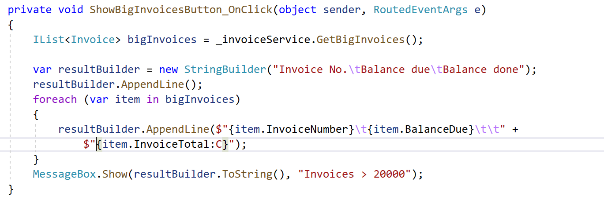
Call of Service method with LINQ query
in Presentation layer

Slide 12
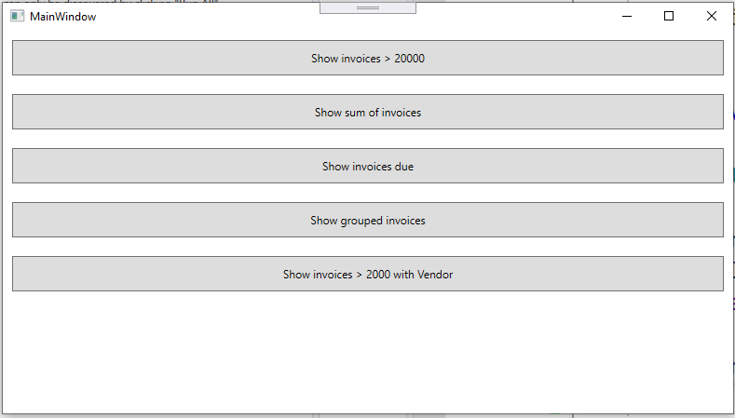
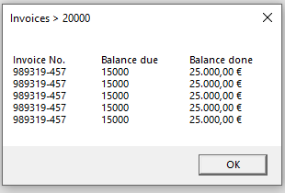
Notes:
12

Slide 13
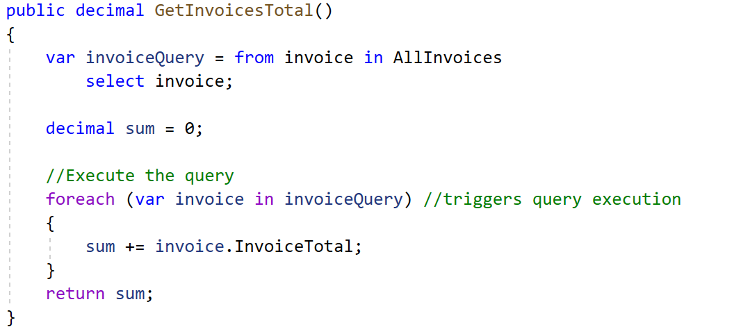
The syntax of the from clause
from [type] elementName in collectionName
Notes:
The from clause
To identify the source of data for a query, you use the from clause shown in this slide.
As you can see, this clause declares a range variable (invoice) that will be used to represent each element of the data source.
The clause also names the data source, which must be an enumerable type.
Note that because the result of a query is an enumerable type, the data source can be a previously declared query variable.
The from clause can also declare a type for the range variable, although the type is usually omitted.
If it is omitted, the type is determined by the type of elements in the data source.
The example in this slide shows how to use the from clause with a generic list of invoices.
Here, the first statement creates a list that's based on the Invoice class and loads invoices into it using the AllInvoices property.
At this stage, all you need to know is that AllInvoices property returns an IList<Invoice> object.
Then, the second statement defines the query expression, which consists of just the from clause and a select clause.
The from clause uses the name invoice for the range variable, and it identifies AllInvoices as the data source.
This expression is then stored in a query variable named invoiceQuery.
Finally, the code that follows uses a foreach statement to loop through the invoices and calculate a sum of the InvoiceTotal field for each invoice.
At this point, you should realize that a query expression must always start with a from clause that identifies the data source.
That way, C# knows what the source of data for the query is, and it can help you construct the rest of the query based on that data source.
In addition, a query expression must end with either a select clause or a group clause.
In the example on the slide, the select clause simply indicates that invoice objects should be returned by the query.
Later in this chapter, however, you'll see that you can use the select clause to return just the fields you want from each element of a data source.
You may have noticed in this example that the variable that's used in the query expression and the variable that's used in the foreach loop have the same name.
That makes sense because they both refer to an element in the data source.
However, you should know that you don't have to use the same names for these variables.
In fact, when you code more sophisticated query expressions, you'll want to use different variable names to indicate the differences between the elements they refer to.
That'll make more sense when you see the group clause later in this chapter.

Slide 14
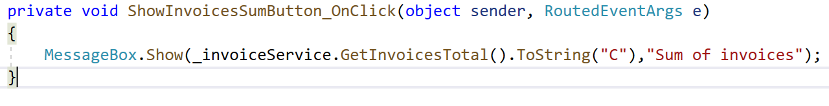
Call of Service method with LINQ query
in Presentation layer

Slide 15
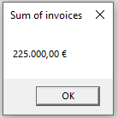
Notes:
15

Slide 16
The syntax of the where clause
where condition
Notes:
The where clause
To filter the results of a query, you use the where clause that's illustrated by the first example on the slide.
On this clause, you specify a condition that an element must meet to be returned by the query.
The condition is coded as a Boolean expression.
In this example, the where clause specifies that the InvoiceTotal must be greater than 2000.
Notice here that the range variable that's declared in the from clause (invoice) is used in the where clause to refer to each Invoice object.

Slide 17
The syntax of the orderby clause
orderby expression1 [ascending | descending]
[, expression2 [ascending | descending]
Notes:
The orderby clause
To sort the results of a query, you use the orderby clause that's illustrated by example on this slide.
Here, the query expression includes an orderby clause that sorts the invoices by InvoiceTotal in descending sequence.
To do that, it uses the range variable that's declared by the from clause to refer to each Invoice object just like the where clause does.

Slide 18
Notes:
The select clause
How to select fields from a query
So far, the queries you've seen in this chapter have returned entire elements of a data source.
To do that, the select clause simply named the range variable that represents those elements.
But you can also return selected fields of the elements.
To do that, you use the select clause shown in this slide.
This clause lets you identify one or more fields to be included in the query results.
A query that returns something other than entire source elements is called a projection.
To illustrate how this works, the first select clause in this slide returns a single field of each element. In this case, it returns the InvoiceTotal property of an invoice object.
The second example shows a query expression that returns multiple selected properties from the invoice objects.
Specifically, it returns the InvoiceNumber and BalanceDue properties.
Notice that the select clause in this example uses an object initializer that starts with the new keyword to create the objects that are returned by the query. Also notice that the object initializer doesn't specify a type. That's because a type that includes just the two properties named in the initializer doesn't exist.
In that case, an anonymous type is created. Because the name of an anonymous type is generated by the compiler, you can't refer to it directly.
In most cases, that's not a problem. If it is, you can define the type you want to use and then name it on the object initializer.

Slide 19
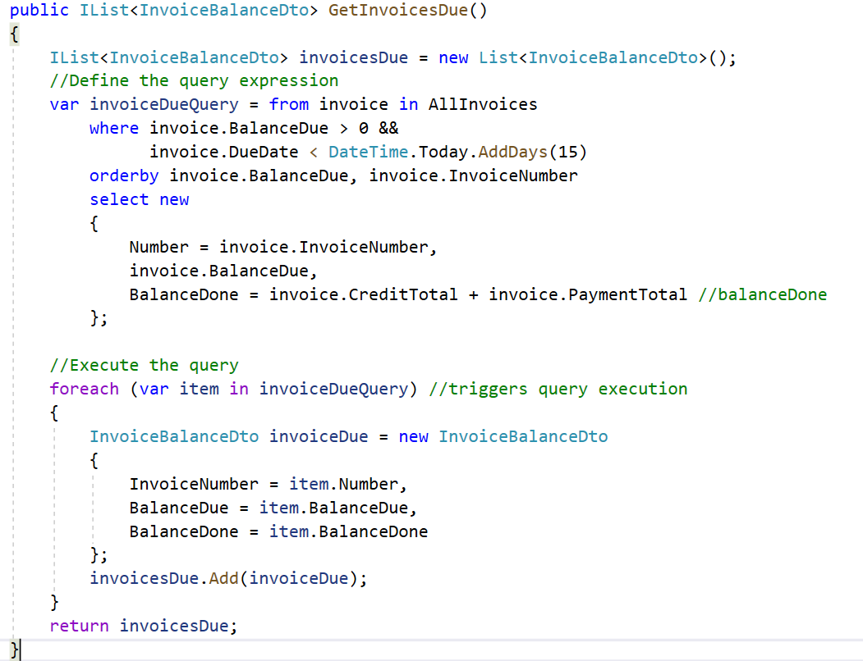
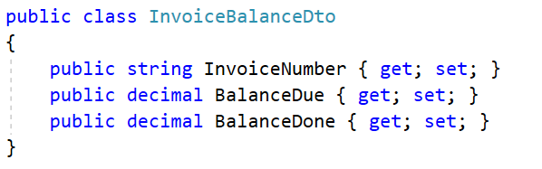
InvoiceBalanceDto.cs
Notes:
The select clause
The example in this slide shows how you can assign an alias to a property in the query results.
Here, the alias Number is assigned to the InvoiceNumber property, and the alias BalanceDone is assigned to the expression that calculates the balance done.
These aliases are then used as the names of the properties in the anonymous type that's created, and you can refer to them when you execute the query.
The property BalanceDue is not aliased so the resulting property name will be BalanceDue.

Slide 20
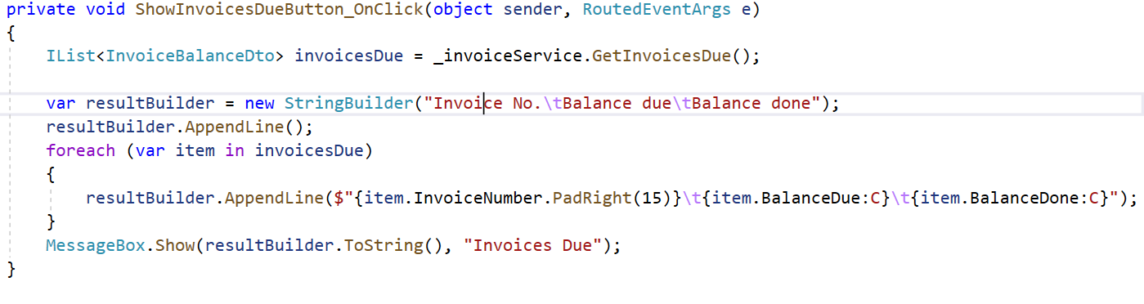
Call of Service method with LINQ query
in Presentation layer

Slide 21
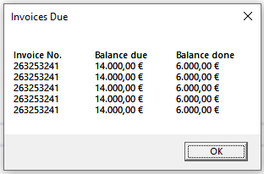
Notes:
21

Slide 22
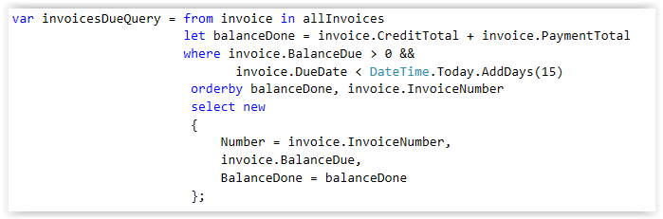
Notes:
The let clause
In the last example, you saw one way to assign an alias to the result of a calculation.
If you need to to a calculation multiple times (e.g. in the orderby and the select clauses), you can use the let clause shown this slide.
As you can see, you can use the let clause to assign aliases to one or more expressions.
In the query expression in this figure, the let clause calculates the balance done for each invoice and assigns the alias balanceDone to the result of that calculation.
Then the orderby and select clauses that follow all refer to this alias.

Slide 23
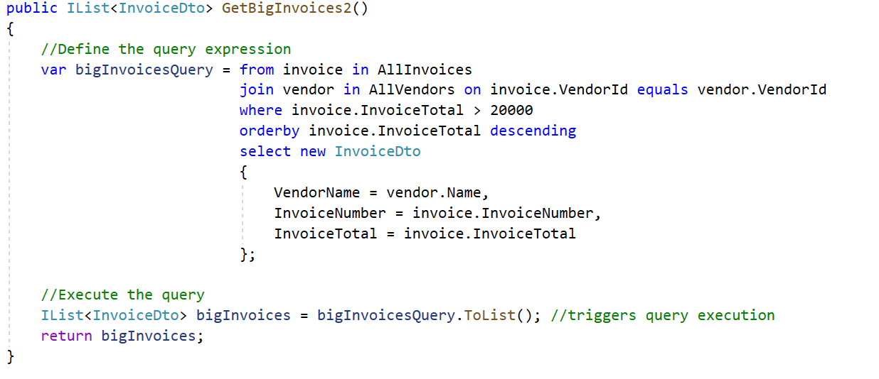
Notes:
The join clause
This slide shows how you can include data from two or more data sources in a query.
One way to do that is to use the join clause shown at the top of this slide.
To start, this clause declares a range variable and names a data source just like the from clause does.
Then, it indicates how the two data sources are related.
To illustrate, the example on this slide joins data from the list of invoice objects you've seen in the previous slides with a list of vendor objects.
To do that, it names the invoice list on the from clause, and it names the vendor list on the join clause.
Then, the On condition indicates that only vendors in the vendor list with a vendorId that matches a vendorId in the invoice list should be included in the results.
Because both the invoice and vendor lists are included as data sources in this query expression, the rest of the query can refer to properties of both invoice and vendor objects.
For example, the orderby clause in this query expression sorts the results by the InvoiceTotal property of the invoice objects.
Similarly, the select clause selects the Name property from the vendor objects and the InvoiceTotal and InvoiceNumber properties from the Invoice objects.
In this case the select clause creates an instance of InvoiceDto directly (instead of an anonymous object).

Slide 24
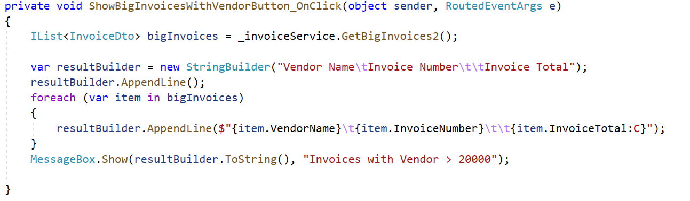
Call of Service method with LINQ query
in Presentation layer
Notes:
The join clause
This example on the slide executes the query. Here again, this code uses a foreach loop to store the query data in a string, and then displays the string in a message box.
Although this example only shows how to join data from two data sources, you can extend this syntax to join data from additional data sources.
For example, suppose you have three data sources named allVendors, allInvoices, and allLineItems.
Then, you could join the data in these lists using code like this:
from vendor in allVendors join invoice in allInvoiced
on vendor.vendorld equals invoice.vendorld join Iineltem in allLineItems
on invoice.invoiceId equals lineltem.invoiceId . . .
Once the three lists are joined, you can refer to properties from any of these lists in the query expression.

Slide 25
Notes:
25

Slide 26
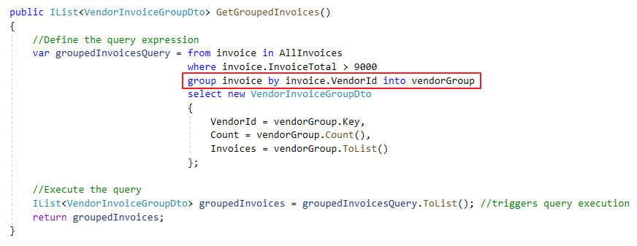
The syntax of the group clause
group elementName by keyExpression [into groupName]
Notes:
The group clause
If you want to group the elements returned by a query, you can use the group clause presented in this slide.
The first query example in this slide shows how to create groups.
To start, you identify the element you want to use after the group keyword. In the query expression in this slide, I used invoice as the range variable for the query, which represents an invoice object.
That way, I can use any of the properties of the invoice object in the group clause.
Next, you code the by keyword followed by a key expression that identifies the fields you want to use to group the elements.
In this example, the invoices will be grouped by vendorId because I have used the vendorId property as the key.
Then, you can optionaly code the into keyword followed by a range variable of the IGrouping<Tkey, Telement> type.
The IGrouping type represents a collection of objects that have a common key.
In this example, that common key will be the vendorId value.
I've named the range variable vendorGroup, and this variable has a key property of type int (holding vendorId value) and is by itself an IEnumarable<TElement> (holding the invoices with the same vendorId)
The final line of the first query example creates an instance of VendorInvoiceGroupDto the same way that you've seen demonstrated in the previous example.
It contains properties that represent the key value (vendorId), the number of invoices for that vendor (being the number of items in the group) and a list of invoices for that vendor (being the items in the group).

Slide 27
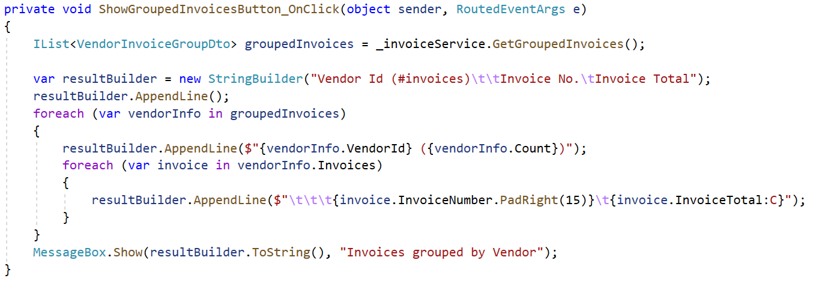
Call of Service method with LINQ query
in Presentation layer

Slide 28
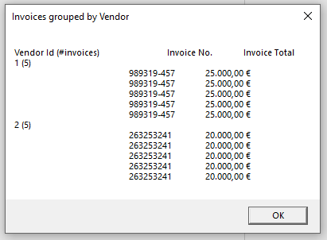
Notes:
28

Slide 29
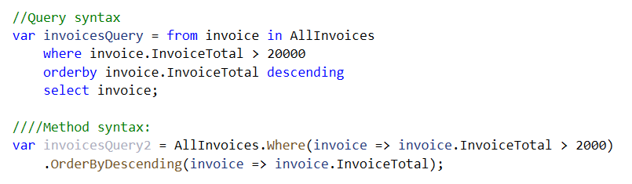
Query syntax vs. method syntax
Under the hood, LINQ translates a query defined using the query syntax to a series of calls to extensions methods on IEnumerable<T>
You can also use these methods directly to define a LINQ query

Slide 30
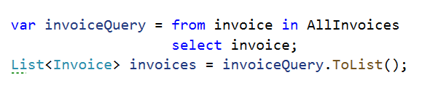

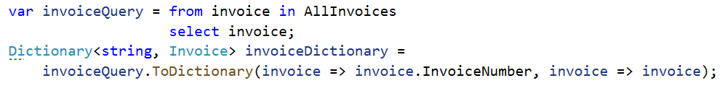
Extension methods that trigger query execution
Linq defines some extension methods on IEnumerable<T> that trigger query execution and return a collection:
ToList -> returns List<T>
ToArray -> returns T[]
ToDictionary -> returns Dictionary<TKey, TElement>
…

